Slide 1

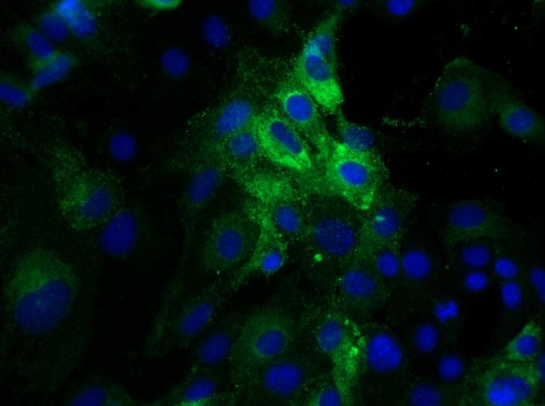
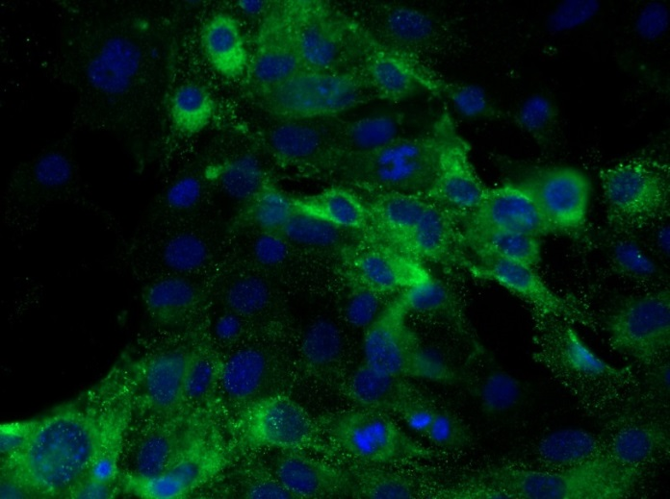
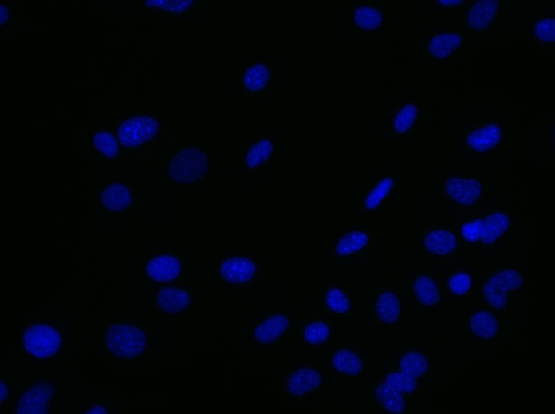
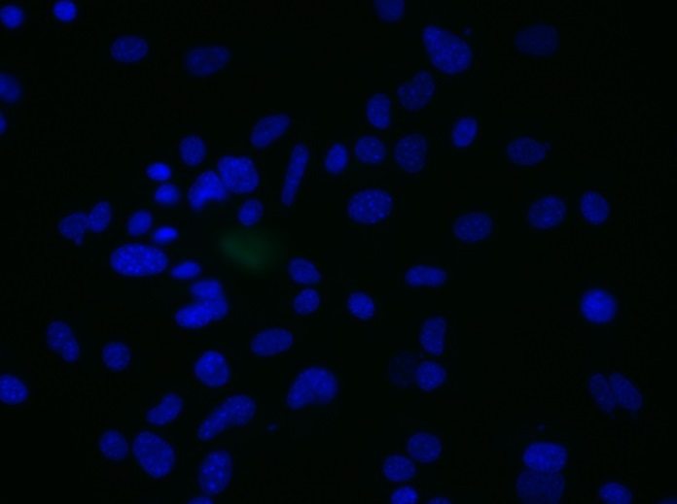
Reliatech GmbH
Rat anti-mouse BEC12
(Cat# 103-M154 [10 µg(ml]; SnoMec)
Immunofluorescence staining of mouse BEC12 antigen (#103-M154) in primary mouse endothelial cells (SnoMec) using a monoclonal antibody directed against with collagenase- and neuraminidase-treated mouse benign lymphangiomas .
As secondary antibody goat anti-rat ALEXA Flour 488 (Dianova; 1:600) was used.
[IF_mEC1407-02]
.
rat anti-mouse BEC12
rat anti-mouse BEC12
Control (goat anti-rat IgG ALEXA Flour 488; 1:600)
http://www.reliatech.de / orders@reliatech.de

